Slide 1
I210 – Introduction to Programming with Python
Lecture 9

Slide 2

Today
Default Arguments
Keyword Arguments
Modules
tools.py

Slide 3
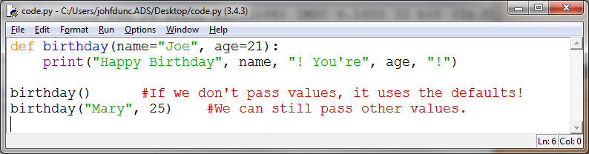
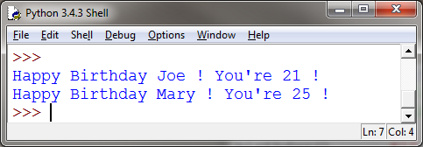
Default Argument Values
If there are common values that get passed in, we can save ourselves the trouble. We can make them default values!

Slide 4
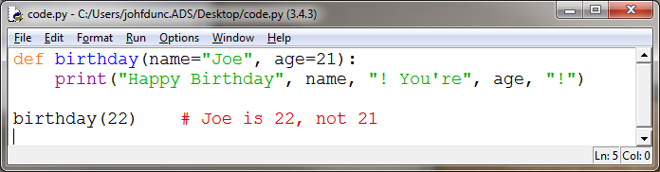
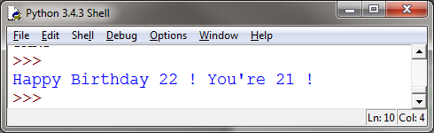
Default Arguments
What if we want to use one default argument, but specify the other one?
Oops! Looks like Python can’t tell what we meant.

Slide 5
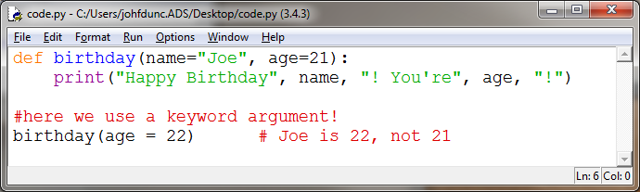
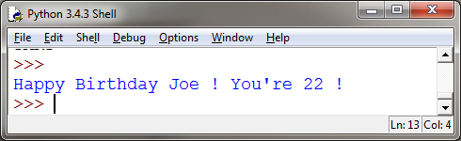
Keyword Arguments
To help Python out, we can indicate which argument we’re specifying. This is called a keyword argument.

Slide 6
Keyword Arguments
You might remember this use of keyword arguments: list.sort(reverse=True)
The implication from that is that .sort() has other arguments that we don’t normally give it – they have defaults! Let’s see an example.

Slide 7
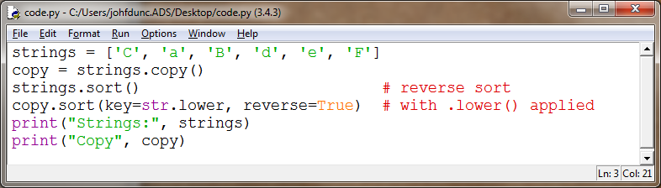
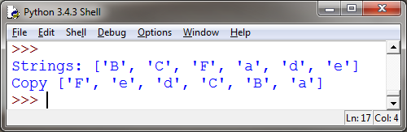
Keyword Arguments
We can also specify a function or method to be considered while sorting. This will treat all strings as if they were lowercase.

Slide 8
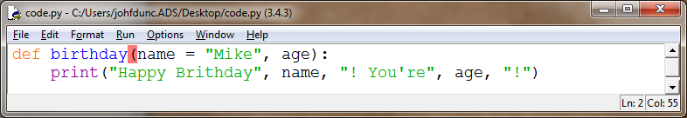
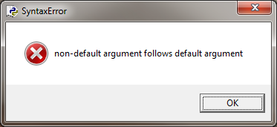
Positional or Keyword? (None or All)
Once you assign a default value to a parameter in the list, you must assign default values to all the parameters listed after it.
STYLE TIP: Assign default values to ALL parameters or NONE of them.

Slide 9
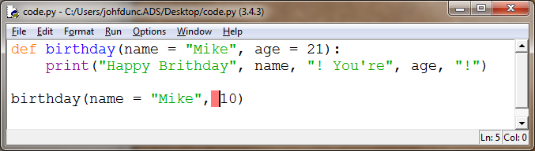
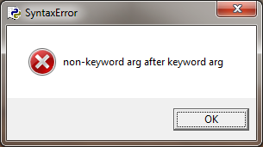
Positional or Keyword? (None or All)
Similarly, once you use a keyword argument, all the remaining arguments in the same call to the function must be keyword arguments.

Slide 10
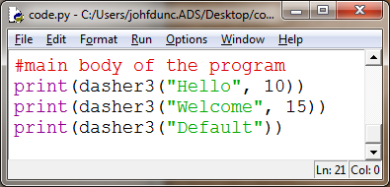
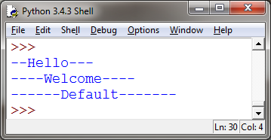
Dasher3 (Group Work) *
Alter the dasher2 function so that the total line length is an argument to the function.
Give this argument a default value of 20.
TIP: This does not involve changing much code! Where did you use the number 20? Change it to the new argument.

Slide 11
Dasher3 (Algorithm)
define a function that takes a string and a length (default 20)
check to see if the string is too long
if so, handle it with an error message
compute the number of dashes as (length – length of string)
start with half the dashes
add the string from the user
add the other half of the dashes
was the number of dashes odd?
add an extra dash if so
return the string

Slide 12
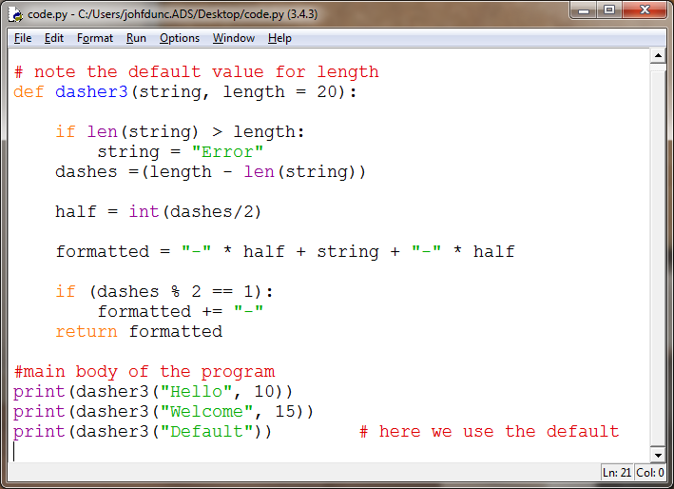
Dasher3 (Solution)

Slide 13


Managing Code
As our programs grow larger, we'll be writing and using more and more functions, and our code will get longer and longer…
Python lets us split a program into multiple source code files, to help keep organized.
Organized tools are more likely to get used!

Slide 14
Modules
module – a single file that contains a large collection of code
Modules can be used by importing them, at which point the code becomes part of the current program.
We’ve already seen the math module! Last time you saw the cards module as well.

Slide 15

Why Modules?
Reuse code
We especially want to reuse functions for different programs
Organize & Manage code
Large projects can be hundreds of thousands of lines long
Would be impossible to maintain in one file
Share code
If you write great code, distributing it as a module makes it easier for others to use
In python, it’s easy to create your own modules!

Slide 16
Writing Modules
A module is a collection of related programming components, like functions, in a single file.
The secret is… you’ve already written modules!
Any file with extension .py (so any python file) is a module!!
The file, games.py, can be imported as games .
The file, tools.py , can be imported as tools .
Anything in the same directory can be imported directly like this!

Slide 17
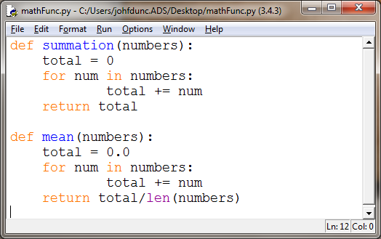
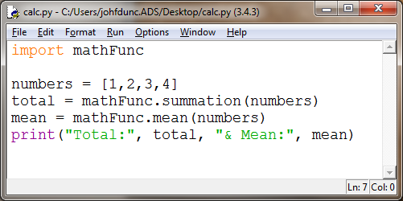
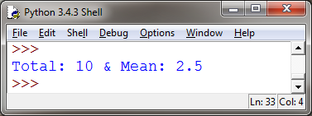
User-defined Modules
Let’s say we’ve written mathFunc.py .
Now we can use these functions in calc.py by importing them!
(This works because they’re in the same directory)

Slide 18
Modules
Modules contain groups of related functions:
math contains a lot of useful mathematical code
Modules can also contain classes or constants
math.pi
When we import a module we then have to say modulename.methodname()
i.e. mathFunc.summation(numbers)

Slide 19
3 Ways to Import
import mathFunc #standard import
mathFunc.summation([1,2,3])
import mathFunc as mfn #we can rename
mfn.summation([1,2,3]) #a module on import
from mathFunc import * #global import!
summation([1,2,3]) #we don't need to use a prefix
The one downside to a global import is that you can’t have functions in the current file with the same name!

Slide 20
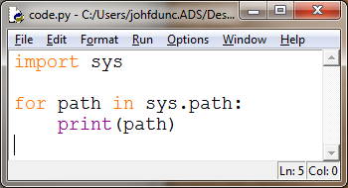
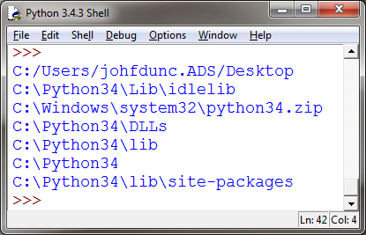
Module Not Found?
When you tell python to import a module, the interpreter searches in a list of directories specified by sys.path :
(Where the code is running!)

Slide 21
Module Not Found?
You can also modify this list directly to tell python to look for modules in other directories:
import sys
sys.path.append('/home/jd/lib/python')
OR
sys.path.append('c:/users/J/Desktop/I210/')

Slide 22
What about Test Code in main?
def summation(numbers):
total = 0
for num in numbers:
total += num
return total
def mean(numbers):
total = 0.0
for num in numbers:
total += num
return total/len(numbers)
#test code
nums = [1,2,3,4]
print(summation(nums) == 10)
print(mean(nums) == 2.5)
Let’s say I add some test code to my mathFunc module.
This code is written so that if I run the module directly, I expect all of my tests to return True.
Now if I import this module, it runs the test code, too!!

Slide 23
What about Test Code in main?
def summation(numbers):
total = 0
for num in numbers:
total += num
return total
def mean(numbers):
total = 0.0
for num in numbers:
total += num
return total/len(numbers)
#test code
if __name__ == "__main__":
nums = [1,2,3,4]
print(summation(nums) == 10)
print(mean(nums) == 2.5)
Adding a single line prevents the test code from running when the module is imported!
This way, we can keep our test code AND have the module be useful.

Slide 24
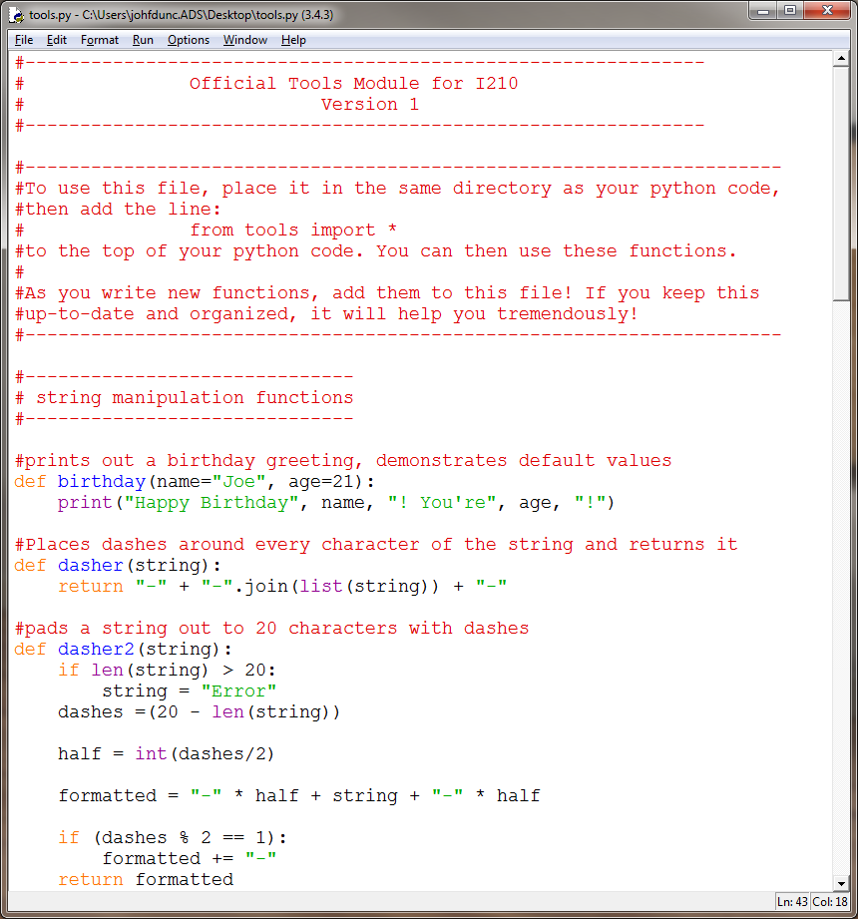
tools.py - Shared Tool Codebase
I’ve placed all the functions we’ve done together in a file called tools.py on Canvas.
If you maintain this…
test.py :
from tools import *
print(dasher("test"))

Slide 25
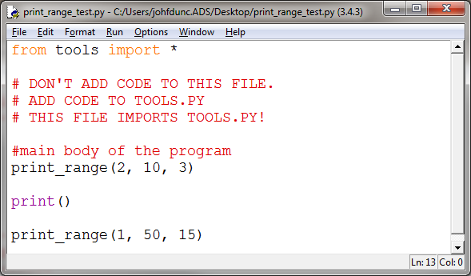
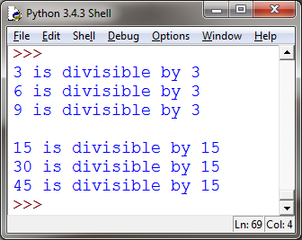
Print Range (Group Work)*
Add a function to tools.py in the Printing Functions section:
The function should be called print_range(low, high, factor)
It prints (not returns) all of the integers from low to high that are divisible by factor.
Call the function from the file print_range_test.py
Notice we’re importing tools.py

Slide 26
Print Range (Algorithm)
Define a function called print_range that takes three values: low, high, and factor
Walk over all of the integers in that range
If the integer is evenly divisible by the factor
Print out a message

Slide 27
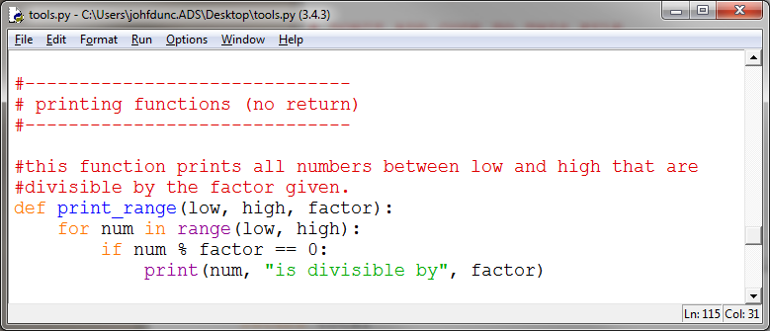
Print Range (Solution)

Slide 28
Questions?

Slide 29
I210 – Introduction to Programming with Python
Lecture 10

Slide 30
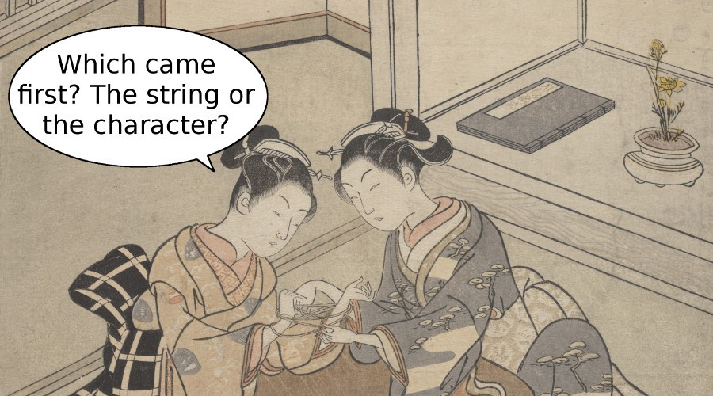
Today
Escape Sequences
Newlines and tabs
String methods
Slicing

Slide 31
Worried about LP 1? Revise it!
From the Syllabus:
Assignment Revision Policy
Assignments (homework, practicals) may be revised for a chance to earn up to 50% of the missed points back. For example, if you received a 70, but on your revised assignment received a 90, your final score will be an 80. You may not revise a score of 0.
You have up to a week from the date that homework is returned to go into any AI or UI lab office hour to revise that work. Course Instructors will not be available to revise assignments.
The final homework assignment and final lab practical may not be revised. Listen carefully for announcements made in class at the end of the semester about which assignments this specifically will apply to.

Slide 32

Key Problems
Starting today, we’ll be adding an icon to the slides.
When you see the gold star, you’ll know we’re on the key problem for the day – the one we expect to be most challenging, most informative, or both.
Make sure everyone in your group is comfortable with your solutions to these problems! They’re also a good idea to revisit for review.

Slide 33
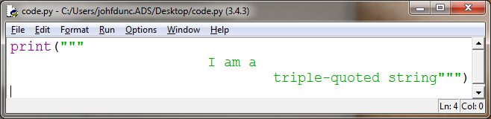
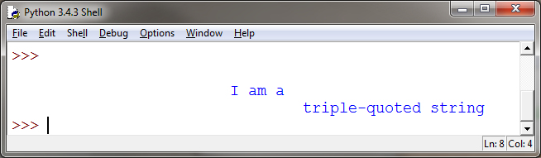
Strings: Using Quotes
Triple-quoted strings can span multiple lines and print out exactly as typed – good for long blocks of text or complex formatting!

Slide 34
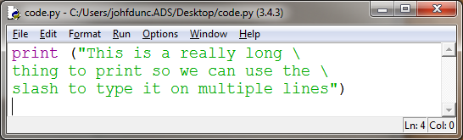
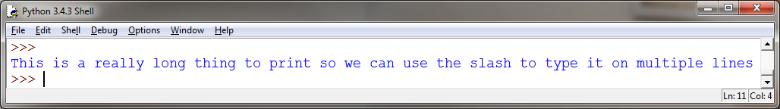
Strings: Line Breaks
Sometimes you'll have a really long string that you want to print on one line…
A \ at the very end of a line tells Python to ignore a line break

Slide 35
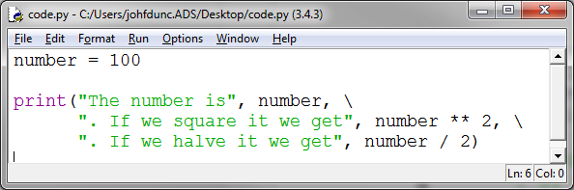
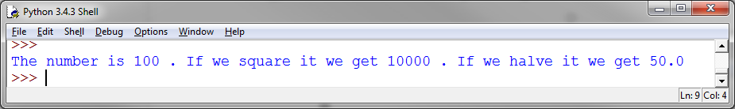
Strings: Line Breaks
We can also combine strings and operators across multiple lines (notice the \ is not in quotes!):

Slide 36
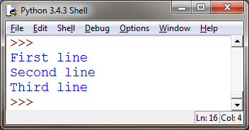
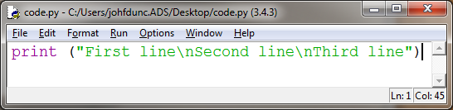
Strings: Using Escape Sequences
Escape sequence: Set of characters that allow you to insert special characters into a string
Backslash ( \ ) followed by another character
Newline character: \n
Escape sequences give you greater control and flexibility over the text you display

Slide 37
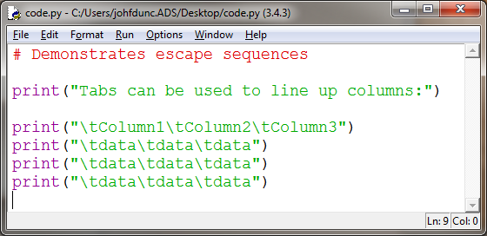
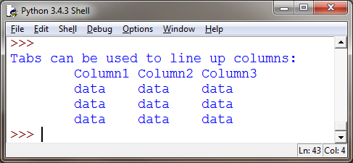
Strings: Using Escape Sequences
Tab character: \t

Slide 38
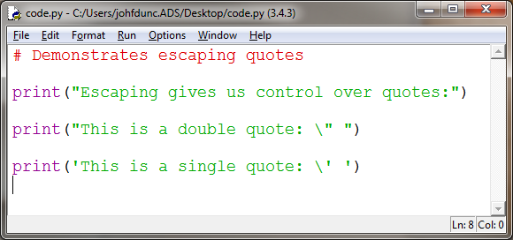
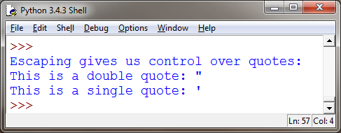
Strings: Using Escape Sequences
We can also escape single or double quotes:

Slide 39
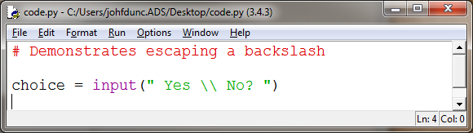
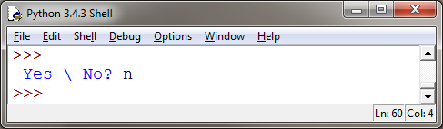
Strings: Using Escape Sequences
Because \ is used in escape sequences, if we just want to print out a "\", we have to escape the escape character!

Slide 40
Using String Methods
String methods allow you to do many things, including:
Create a new string with different formatting (upper case, lower case, title capitalization)
Convert a string (to a list, by replacing or removing portions)
Tell us things about the string (index positions of elements, number of occurrences)

Slide 41
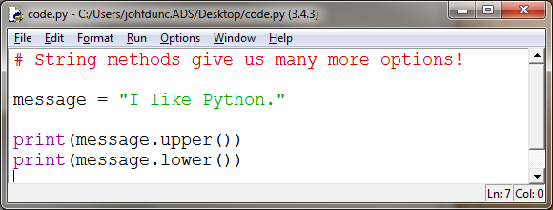
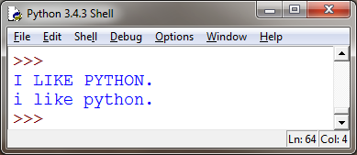
String Methods!
These two can be useful to test user input:
Compare user_text.upper() to "YES", so the user can enter "yes" or "Yes" or "YeS"
.upper(), .lower()

Slide 42
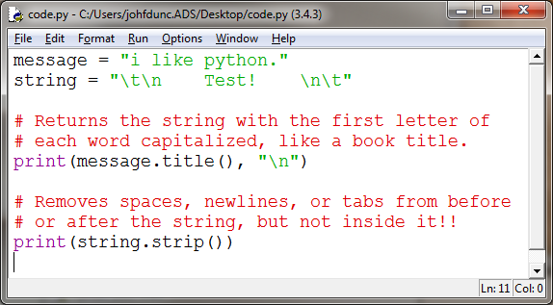
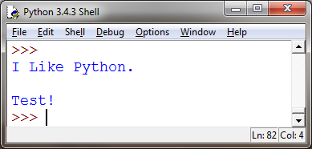
String Methods!
.title(), .strip()

Slide 43
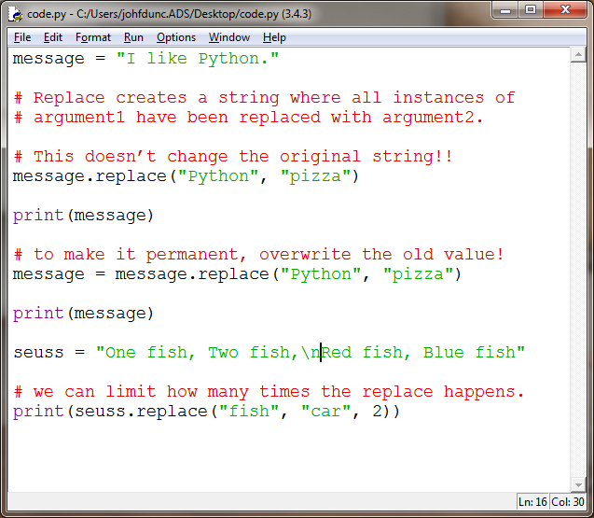
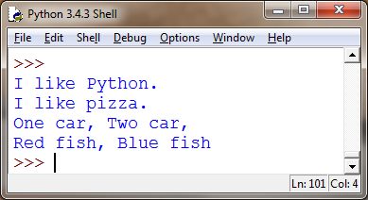
String Methods!
.replace()

Slide 44
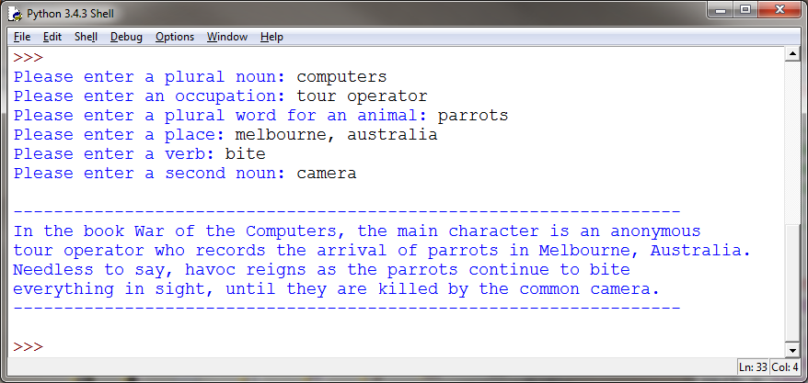
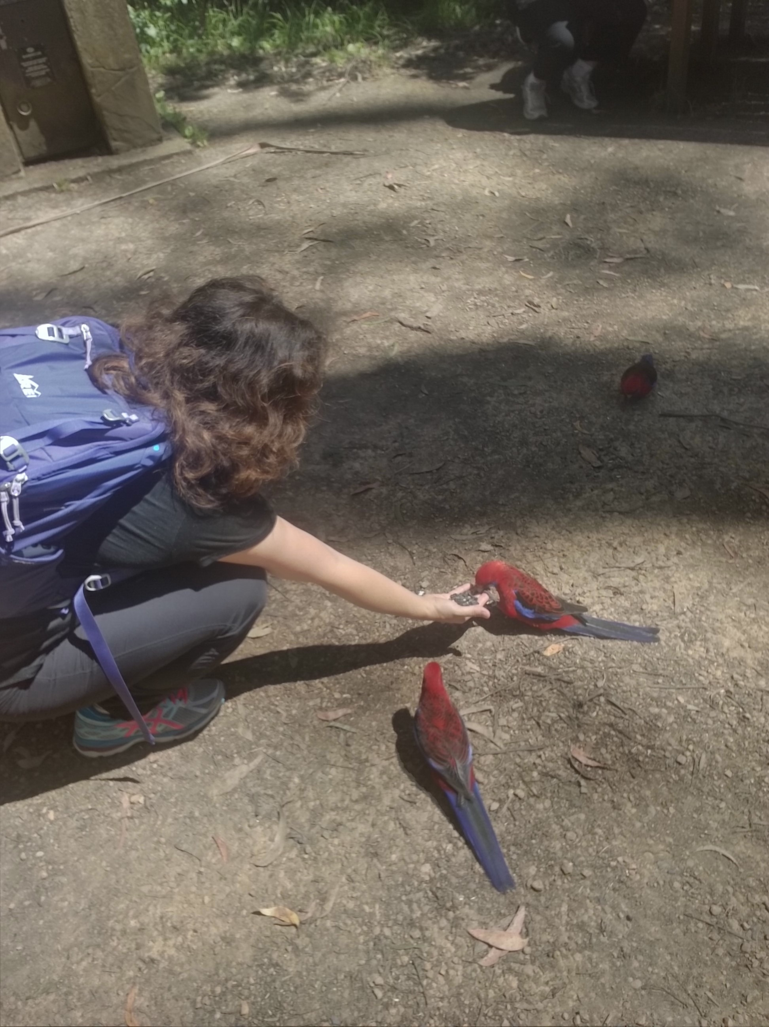
Mad Lib (Group Work)
Download mad_lib_starter.py from Canvas, and write a program that can fill the blanks in on this Mad Lib! Hint: Notice some words get capitalized!
From: http://www.madtakes.com/libs/001.html

Slide 45
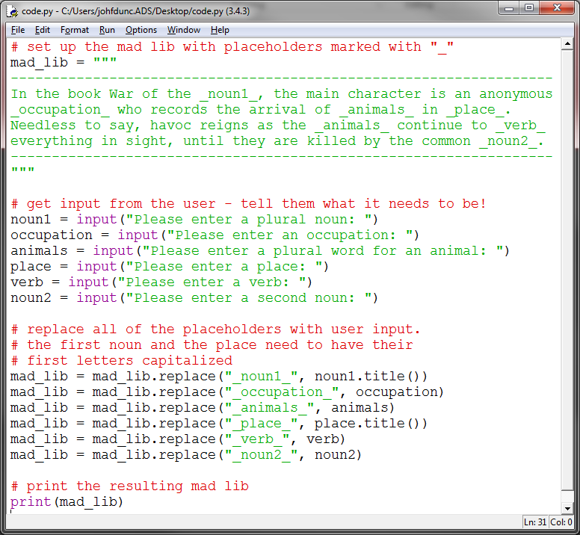
Mad Lib (Solution 1)

Slide 46
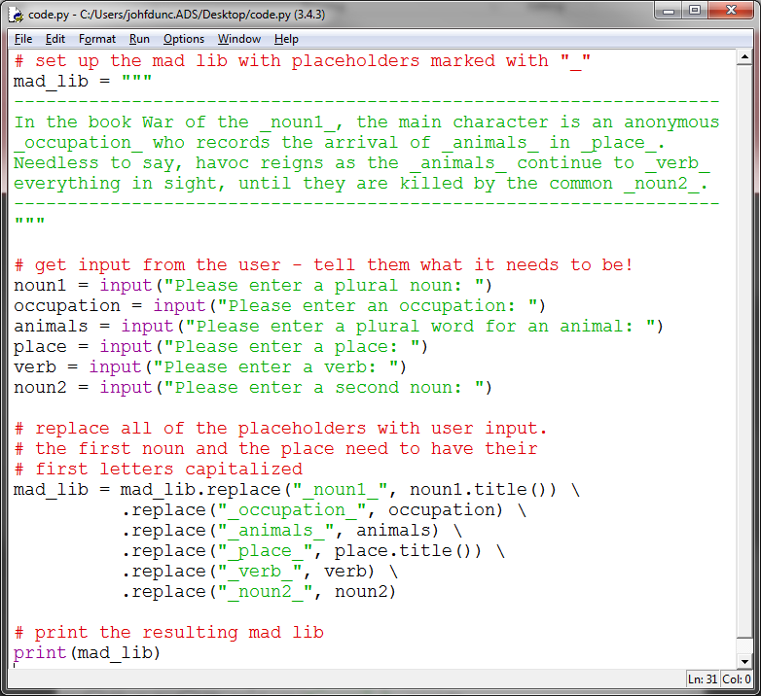
Mad Lib (Solution 2)

Slide 47
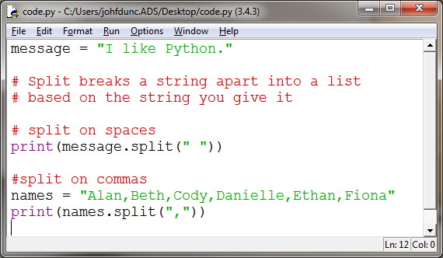

String Methods!
.split()

Slide 48

Longest Word (Group Work) *
Write a program that can replicate these exchanges:

Slide 49
Longest Word (Algorithm)
Get a message from the user
Break it apart into a list of words
Create a variable for the longest word
Walk through the words
Check to see if each word is longer
If it is, update out variable
Print out what we found

Slide 50

Longest Word (Solution)

Slide 51


String Methods!
.count()
.find()

Slide 52


String Slicing
We can use slicing (and index numbers) to retrieve sections of a sequence:
The format is string [first index : last index]
Last index is NOT included!

Slide 53


Slicing Shorthand

Slide 54

Word Triangle (Group Work) *
Use slicing to write a program that can replicate this exchange:

Slide 55
Word Triangle (Algorithm)
Get a message from the user
Walk through the message using index numbers
Print a slice from the beginning to the current position

Slide 56

Word Triangle (Solution)

Slide 57
Questions?

Slide 58
I210 – Introduction to Programming with Python
Lecture 11

Slide 59

Today
Formatting Output
Nested Sequences
Table Print

Slide 60


Formatting Output
We’ve seen that we can control the end character to suppress the automatic newline:

Slide 61


Formatting Output
We can also automatically insert a separator when we print:

Slide 62

Nested Sequences
Lists and Tuples can have other Lists and Tuples as items (nesting)!!
nested_list = [("Python","PHP"), "Hello", [23, 4]]
nested_tuple = (("Python","PHP"), "Hello", [23, 4])

Slide 63
Nested Sequences
scores = [("Abe", 200), ("Bill", 180), ("Mary", 215)]
We can think of this list as a table:
 | Name (col 0) | Score (col 1)
Row 0 | “Abe” | 200
Row 1 | “Bill” | 180
Row 2 | “Mary” | 215

Slide 64


Nested Sequences
Compare the output for these methods of printing the contents of a nested sequence:
Which one looks more like a table?

Slide 65


Nested Sequences
If we know exactly how many pieces are in the inner sequence, we can do what’s called unpacking.
Unpacking assigns the pieces of the inner sequence to multiple variables at once!
This can be better when using entry[0] or entry[1] is confusing.

Slide 66


Nested Sequences (Table Print 1)
If we need index numbers, we can double index:
The value of i is the row – it determines which tuple we have.
The [0] or [1] after it gets us the name or score from that tuple.
i | Name (col 0) | Score (col 1)
Row 0 | “Abe” | 200
Row 1 | “Bill” | 180
Row 2 | “Mary” | 215

Slide 67

Table Print 2 (Group Work)
→ Download table_print_starter.py from Canvas.
Convert table print into a function!
When working correctly, the program should output this:

Slide 68

Table Print 2 (Solution)

Slide 69


Formatting Output
We run into this situation a lot, where we need to output a lot of variables in a very specific way:
I ran this program 3 times before I got everything to line up the way I wanted!

Slide 70

Formatting Output
Python provides the .format() method for strings, which can make this process less error-prone:
We can immediately see what the final output will look like by how we space the { }

Slide 71
Formatting Output
Let’s say we want to print out a date as Month Day, Year:
month = "May"
day = 23
year = 2016
output = "{0} {1}, {2}"
print(output.format(month, day, year))
>> May 23, 2016
Notice that .format also converts the ints to strings.

Slide 72


Formatting Output
If we need to print out several dates, it's now very easy to do so by changing the variables we pass to .format

Slide 73


Formatting Output
Let’s say we want to compare the growth of 3 functions: n³ 2^{n} 5n

Slide 74


Formatting Output
Let’s say we want to compare the growth of 3 functions: n³ 2^{n} 5n

Slide 75


Formatting Output
Let’s say we want to compare the growth of 3 functions: n³ 2^{n} 5n

Slide 76


Formatting Output
.format() also allows us to specify a minimum number of characters AND whether we want to left-align or right-align the data:

Slide 77

Formatting Output
If we want to control the width, we have options.

Slide 78

Formatting Output
If we want to control the width, we have options.

Slide 79


Formatting Output
We have to be careful to remove the numbers in our placeholders! Otherwise…

Slide 80

Using Width-Controlled Templates
To produce clean output, we can use a template that automatically controls the width of the data that will fill the placeholders:
Template: "{:>{}} is majoring in {:<{}}"
Size for column 1
Size for column 2

Slide 81

Using Width-Controlled Templates

Slide 82


Table Print 3 (Group Work) *
Change table print by removing the column for i and adding the ability to pad the rows to a custom number using .format()
HINT: Use the same width for both columns!

Slide 83
Table Print 3 (Algorithm)
Define a function called table_print that takes headers, data, width
Specify the output template with placeholders for width
( You can use either option to define the output string!)
Using .format and width, print the headers (assume only 2 per row)
Print as many dashes as there are columns,
times the width value (plus 1 for the space)
Using .format and width, print out the data values (assume only 2 per row)

Slide 84

Table Print 3 (Solution 1)

Slide 85

Table Print 3 (Solution 2)

Slide 86
Questions?

Slide 87
I210 – Introduction to Programming with Python
Lecture 12

Slide 88

Today
Reading from Files
Writing from Files
OS Module

Slide 89


Working with Files
To pull in data from other sources, we need to be able to read from files.
To save data between program executions, we need to be able to write to files.

Slide 90

Working with Files
Opening a file:
text_file = open("test.txt", "r")
"r" is the access mode. In this case, it’s read.
This creates a file object called text_file.
Closing a file: Always close open files!
text_file.close()
test.txt

Slide 91
Reading from Files
We can read an entire file at once:
# .read() returns the entire file as a string
file_contents = text_file.read()
print(file_contents)
If we want to be able to use string methods, this is our best choice for reading a file!

Slide 92
Filename Extensions
It’s important to know the exact name of the file we want to interact with!
text_file = open("test.txt", "r") vs
text_file = open("test.txt.txt", "r")
OS file systems don't always show filename extensions, which sometimes causes confusion:
what if a file is named myprogram.py but you only see myprogram ?
what if a file shows up as myfile.py but it's really named myfile.py.txt ?

Slide 93
Filename Extensions
Make sure that your system shows all filename extensions!
Instructions for Windows:
http://www.file-extensions.org/article/show-and-hide-file-extensions-in-windows-10
http://www.eightforums.com/tutorials/30434-file-name-extensions-hide-show-windows-8-a.html
http://windows.microsoft.com/en-us/windows/show-hide-file-name-extensions
Instructions for Mac OS X:
http://osxdaily.com/2012/01/13/show-filename-extensions-in-mac-os-x/
http://support.apple.com/kb/PH10845

Slide 94
Basic File Use (Group work)
For 1 point, put these pieces in the right order to open a file and print its contents.
text_file.close()
text_file = open("test.txt", "r")
print(file_contents)
file_contents = text_file.read()
Download test.txt from Canvas, and put it in the same directory as your .py file!
It should print out the 4 lines in the file. Confirm that this works so you can show us!

Slide 95
Basic File Use (Solution)
#Either of these opens a file, reads it in as a string,
#prints out the string, then closes the file.
text_file = open("test.txt", "r")
file_contents = text_file.read()
text_file.close()
print(file_contents)
text_file = open("test.txt", "r")
file_contents = text_file.read()
print(file_contents)
text_file.close()

Slide 96
Reading from Files
A note about reading from files:
If you hit the Enter key in a text file, it adds a "\n" that’s invisible.
If the file contains a blank line, Python will still read the "\n”.
When you print this out, you’ll just see a blank line.

Slide 97


Reading from Files
You can also read lines into a list: (our default if you want to use list methods!)

Slide 98


Line Cleaning
HINT: If your lines are numbers, and you want the \n removed, you can just int() or float() them!

Slide 99
File Sum (Group Work) *
Write a program that reads the numbers from the file, and prints out their sum.
→ Download numbers.txt from Canvas.
>>>
The total is: 56

Slide 100
File Sum (Algorithm)
Open the file “numbers.txt” in read mode
Read in the lines as a list
Close the file
Start a count at 0
Walk through each of the lines
Convert the line to an integer and add it to the count
Print out the final count

Slide 101

File Sum (Solution 1)

Slide 102

File Sum (Solution 2)

Slide 103

Files
This is an alternate way to interact with a file:
The with keyword creates a code block. After that code block finishes, the file is automatically closed!

Slide 104
Writing to a File
text_file = open("write_it.txt", "w")
“w” is write mode. This allows us to create files!
The file write_it.txt springs into existence as an empty text file.
If the file write_it.txt had already existed, it would have been replaced with a brand‐new, empty file and all of its original contents would have been erased.

Slide 105
Writing to a File
Writing to a file is very similar to reading from one.
This creates a file called “write_it.txt” with three lines:
text_file = open("write_it.txt", "w")
text_file.write("Line 1\n")
text_file.write("This is line 2\n")
text_file.write("That makes this line 3\n")

Slide 106
Writing to a File
Nothing is actually written until you close the file.
Make sure you close the file after writing to it!!
text_file = open("write_it.txt", "w")
text_file.write("Line 1\n")
text_file.write("This is line 2\n")
text_file.write("That makes this line 3\n")
text_file.close()

Slide 107
Writing to a File
We can write from a list to a file:
lines = ["Line 1\n", "This is line 2\n", "That makes this line 3\n"]
text_file.writelines(lines)
Line 1
This is line 2
That makes this line 3
Lists are a great intermediary data structure for files!

Slide 108
File Access Modes
Mode | Description
"r" | Read from a text file. If the file doesn’t exist, ERROR.
"w" | Write to a text file. If the file exists, it is overwritten. If it doesn’t exist, it is created.
"a" | Append to a text file. If the file exists, new data is added onto the end. If it doesn’t exist, it is created.
"r+" | Read and write to a file. If the file doesn’t exist, ERROR.
"w+" | Read and write to a file. If the file exists, it is overwritten. If it doesn’t exist, it is created.
"a+" | Append and read to a file. If the file exists, new data is added onto the end. If it doesn’t exist, it is created.

Slide 109
File Locations
If you just specify the name of the file, Python looks for it in the same directory as the .py file you’re running.
You can also specify the path manually:
Windows:
text_file = open("C:/Users/J/Desktop/test.txt", "r")
Mac OS X:
text_file = open("/Users/J/Desktop/test.txt", "r")

Slide 110
File Locations
You can use this to get the path to the directory where your .py file is running:
import os
path = os.getcwd() #get current working directory
print(path)
>>>
C:\Users\johfdunc.ADS\Desktop

Slide 111
File Copy (Group Work) *
Write a function, copy_file(filename_from, filename_to) that copies the contents of a file to another file.
→ Get started with copy_test.py on Canvas!
NOTE: This function doesn’t need to produce output in IDLE! It copies the file, producing a new file.
Hints:
The arguments are the NAMES of the files, not file objects
Don’t forget to .close() files you open()
"r" is read, "w" is write

Slide 112
File Copy (Algorithm)
This function takes a to file and a from file
Open the from file in read mode
Read the data from it
Close the file
Open the to file in write mode
Write the data to it
Close the file
Write some test code for the function

Slide 113
File Copy (Solution 1 with Test)
def copy_file(filename_from, filename_to):
file = open(filename_from, "r")
data = file.read()
file.close()
file = open(filename_to, "w")
file.write(data)
file.close()
#testcode
file_f = input("Please enter the name of the file to copy FROM: ")
file_t = input("Please enter the name of the file to copy TO: ")
copy_file(file_f , file_t )

Slide 114
File Copy (Solution 2 with Test)
# using with can make this very short!
def copy_file(filename_from, filename_to):
with open(filename_from, "r") as f:
data = f.read()
with open(filename_to, "w") as f:
f.write(data)
#testcode
file_f = input("Please enter the name of the file to copy FROM: ")
file_t = input("Please enter the name of the file to copy TO: ")
copy_file(file_f , file_t )

Slide 115
OS Module (Used a lot in I211)
When working with files, the os module is very useful. Here, we list the contents of the current directory:
import os
#getcwd comes from ‘GET Current Working Directory’
contents = os.listdir(os.getcwd())
print(contents)
>>>
['code.py', 'Collegium Work', 'desktop.ini', 'Fall 14 Schedule.txt', 'I210 - Syllabus.docx', 'I211 - Syllabus.docx', 'notes.txt', 'Other', 'pickles1.dat', 'Spring 15 Schedule.txt', 'Teaching', 'tools.py']
(The items in blue are directories – they don’t have an extension!)

Slide 116
Text File List (Group Work) *
Print out a list of all text files (.txt extension) in the current directory.
Download Sample_Directory.zip from Canvas and unzip (extract) – it contains blank .txt files, a directory, and a .py starter file!
You’ll need os.getcwd() and os.listdir(), so the starter file has the code on the previous slide!
>>>
This program prints out all the .txt files in the current directory.
Current directory's text files:
['classes.txt', 'data.txt', 'grades.txt', 'problems.txt', 'programs.txt']

Slide 117
Text File List (Algorithm)
Import the os module
Get a list of all files in the current directory, using os.listdir() and os.getcwd()
Start a new list
Walk through the files in the current directory
If the current file ends in .txt
Add it to the list
Print out information about what we’re doing
Print out the list of txt files

Slide 118

Text File List (Solution 1)

Slide 119

Text File List (Solution 2)

Slide 120
Questions?

Slide 121
I210 – Introduction to Programming with Python
Lecture 13

Slide 122

Today
While loops
break

Slide 123
Repetition
Sometimes, we want a loop, but we don’t know how many times we need to loop.
Example: Accept input until told to stop.
We use a type of loop known as a while loop
While loops continue until a Boolean Condition becomes False

Slide 124
While loops
while Boolean Condition:
# We do whatever's in the code block while
# the Boolean Condition is True
# We pick up here when the Boolean Condition
# becomes False

Slide 125


While loops

Slide 126
While loops
Sentry variable / loop control variable:
Variable used in loop condition
Infinite loop: A loop that will never end; considered a logical error
An infinite loop where the sentry variable is never updated is easy to track down.
But some forms of this error that are harder to fix…

Slide 127

Easily Fixed Infinite Loop
>>>
Please enter a username:
You didn't enter anything!
Please enter a username: test
You didn't enter anything!
Please enter a username: test
You didn't enter anything!
etc…
name and username are not the same variable!

Slide 128

Stopping an Infinite Loop
If you get a fast infinite loop:
Don’t panic
Restart IDLE (Shell-> Restart Shell)
Or, you can hit Ctrl-F6
while True:
print("Wheeeeeeee!")

Slide 129

A More Challenging Infinite Loop

Slide 130

Tracing
If something’s going wrong, we may want to perform a trace on the sentry variable.
This just means using print() to output its value at each iteration in the loop.

Slide 131

Tracing in a Loop
Question:
What happens when we run this for 12 donuts?
How about 13?

Slide 132
Fix It! (Group Work)
→ Download donut_starter.py from Canvas.
Fix the problem as follows:
Change the Boolean Condition so that if there aren’t 3 donuts to give out, the remainder are “left over” and not given to Aaron, Beth, or Cody.
Print out how many are left over, but only when the loop stops!
If they really did eat ALL the donuts, print out the original message.

Slide 133

Fix It! (Solution)

Slide 134
Creating Intentional Infinite Loops
Intentional infinite loop
Has True for its Boolean Condition
Written with an exit in the loop body
Sometimes cleaner to write than alternative loop
while True:
# Do stuff
So… how do we exit such a loop?

Slide 135
Break
We have a special instruction for loops: break.
break means we stop executing the current loop immediately, regardless of what the Boolean condition says.
“break out of it”

Slide 136
While loops with break
while Boolean Condition:
#code that might be in the loop
if Other Boolean:
break
#other code that might be in the loop
#We pick up here when Boolean Condition
# becomes false or if we break from the loop

Slide 137
The break statement
for variable in sequence:
#code for loop
if Boolean Condition:
break # appears on a line by itself!
#code for loop
break can also be used to leave a for loop!

Slide 138

Intentional Infinite Loops
while True:
name = input("Please enter your name: ”)
# end loop if user enters something (Remember, "" is False)
if name:
break # appears on a line by itself!
print("You entered:", name)
while True is an intentional infinite loop You must provide a break statement to leave the loop!

Slide 139

File Break (Group Work) *
Write a program that asks the user to enter filenames, and outputs information about the files. Allow the user to stop the program when they are done. HINT: You REALLY want an intentional infinite loop here.

Slide 140
File Break (Algorithm)
Until we tell the program to stop
Get a file name from the user
If that file name is “STOP”
Stop the program by breaking out of the loop
Open a file object to read the file
Read the contents in as a list
Close the file
Output how many lines long the file is

Slide 141

File Break (Solution)

Slide 142

2 Basic Types of Loop
while loop:
Sentry variable (usually)
Repeat until Boolean Condition is false
Use when you don’t know how many times to loop
for loop:
Repeats over a fixed length sequence
Often, the loop control variable is a numeric counter.
Use when you know how many times to loop
VS
For and While are equivalent in power!! But usually one is more straightforward for a given problem…

Slide 143
Counting
>>>
0
1
2
3
4
5
6
7
8
9
While Loop:
count = 0
while count < 10 :
print count
count += 1
For loop:
for i in range(10):
print i
VS
In this example, while is much more work to get the same output!

Slide 144
The 5 types of Loops
while True:
# don't forget to update # your loop control variable!
while num != 4:
# don't forget to update # your loop control variable!
for i in range(len(sequence)):
# use an index number
# to accomplish something
for i in range(number):
# use when we want to do
# something number times
for element in sequence: # do something to each element
# we don’t care about an index
Use an intentional infinite loop if you need to run at least once, but aren’t sure how many times overall.
Use a while loop with a Boolean Condition if you need to loop an indeterminate amount, including not at all. You should not duplicate code.
Use a for loop with range and a numeric loop control variable if you need to know where you are in a sequence. Single letter variable.
Use a for loop with range to repeat something a fixed number of times. Single letter variable.
Use a for loop over a sequence if you just need to do something to each element, with no index numbers.

Slide 145
The 5 types of Loops
Do we know how many times we need to repeat the loop?
No
Yes
Run at least once?
Do we need to know where we are in the sequence, or are we repeating a fixed number of times with no sequence?
No
Yes
while Boolean Condition:
while True:
Yes
No
Repeating a fixed number of times with no sequence?
for piece in sequence:
Yes
No
for i in range(len(sequence)):
for i in range(number):

Slide 146
Number Sum (Group Work) *
Write a program to take numbers from the user until they enter some special input, like "STOP". Print the sum of the numbers entered.
Hint: while is the right tool for this problem!
>>>
Please enter a number or STOP: 1
Please enter a number or STOP: 3
Please enter a number or STOP: 5
Please enter a number or STOP: STOP
The total sum is 9

Slide 147
Number Sum (Algorithm)
Start a total at 0
Get input from the user
While the input isn't "STOP"
Convert the input to an int and add it onto the total
Get more input from the user
When they’re done, print out the total

Slide 148

Number Sum (Solution 1)

Slide 149

Number Sum (Solution 2)

Slide 150
Questions?

Slide 151
I210 – Introduction to Programming with Python
Lecture 14

Slide 152

Today
More Debugging
Error Types
Nested For Loops

Slide 153
Typical software engineer's day…

Slide 154
Typical software engineer's Programming time…
Source:
Britton et al 2012

Slide 155

Debugging
Every programmer creates bugs when they write code!
But you can reduce them by:
Thinking through the algorithm before coding
Following good coding practices while coding
Clear variable names, formatting, comments
Test your code as you write it, not at the end!
Coming up with multiple sets of test data

Slide 156
IDLE’s Messages
Pay attention to the error messages you get from IDLE!
They will often tell you what seems to be going wrong, and where (generally) to look.
But IDLE's error messages are just its guess about what is wrong with your code
Sometimes an error is a symptom of another problem in your code.
The error may not be where Python thinks it is! Look above as well.

Slide 157
SyntaxError
>>> var1 = var2 /
SyntaxError: invalid syntax

Slide 158

NameError
>>> variable1 = variable2 + 10
Traceback (most recent call last):
File "<pyshell#5>", line 1, in <module>
variable1 = variable2 + 10
NameError: name 'variable2' is not defined

Slide 159

TypeError
>>> "string" / "otherstring"
Traceback (most recent call last):
File "<pyshell#17>", line 1, in <module>
"string" / "otherstring"
TypeError: unsupported operand type(s) for /: 'str' and 'str'

Slide 160

ValueError
>>> int("five")
Traceback (most recent call last):
File "<pyshell#18>", line 1, in <module>
int("five")
ValueError: invalid literal for int() with base 10: 'five'

Slide 161

ZeroDivisionError
>>> 100 / 0
Traceback (most recent call last):
File "<pyshell#19>", line 1, in <module>
100 / 0
ZeroDivisionError: integer division or modulo by zero

Slide 162

IndexError
>>> message = "hello"
>>> message[5]
Traceback (most recent call last):
File "<pyshell#1>", line 1, in <module>
message[5]
IndexError: string index out of range

Slide 163

Debugging logic errors
Often IDLE runs your code without any errors, but your code doesn't do what you wanted (logic error!).
How do we debug logic errors?
Problem-solving skill
Practice is key!

Slide 164
Debugging strategy 1: Tracing
Performing a trace helps discover what’s happening to variables inside of a program.
Add print() statements to output values when they change.
Once you’ve solved the current problem:
Don’t immediately delete your traces! Comment them out instead. There may be another problem.

Slide 165
Tracing with a Boolean
If you want to be able to easily turn all of your traces On/Off, try this:
At the top of the program:
debug = False
In the code:
if debug: print(value)
Now, changing the value of debug to True or False enables or disables your traces!

Slide 166
Strategy 2: Manual Walk-Through
Try simulating what the computer does as it processes your code, line by line.
Write down the changes to variables, test Boolean Conditions, etc.
Match this up to the output you got when you traced to make sure you’re simulating correctly.

Slide 167



Strategy 3: Pair Debugging
Explain what your code does to someone else.
Voicing your thoughts out loud will help find places where your logic is incorrect, or where the code doesn’t do what you think it does. Our brains work differently when we read vs speak!

Slide 168
Long-Term Techniques
Multiple versions – when you finish a significant step, save a copy! If you break things and can’t fix them, you can go back.
Comment sections out – Use IDLE’s ability to comment large blocks out to remove troublesome code. (Format -> Comment Out Region)
Add code back in slowly to find the place where the bug is occurring.

Slide 169
Nesting Review
for i in range(3):
for j in range(5):
print("*", end='')
print()
>>>
* * * * *
* * * * *
* * * * *
3 rows and 5 columns!
Remember, i and j are traditionally used as counters for nested loops, followed by k, etc.
i = row
j = column

Slide 170
Debugging A Nested Loop (Group Work)
Someone wrote this code without testing it!
We want the code to do this: Debug the code!
>>>
How many rows should we have? 5
How many columns should we have? 6
Row 0 : 0 1 2 3 4 5
Row 1 : 0 1 2 3 4 5
Row 2 : 0 1 2 3 4 5
Row 3 : 0 1 2 3 4 5
Row 4 : 0 1 2 3 4 5
This is the current code: (bad_loops.py on Canvas)
cols = input("How many rows should we have?")
rows = input("How many columns should we have?"
for i in range(rows)):
print("Row", j, ":", end = '')
for j in range(cols):
print(j)

Slide 171

Debugging A Nested Loop (Solution)

Slide 172

Multiplication Table v1 (Group Work)
Print out a multiplication table (10 x 10).
You’ll need nested for loops for this problem, but think about how to produce the first row before moving on.
Bugs? Use the techniques we’ve talked about today.
You may need to widen IDLE’s window!

Slide 173

Multiplication Table v1 (Solution)

Slide 174

Multiplication Table v2
It’s a better table with labels:

Slide 175
Multiplication Table v2 (Group Work)
Print your table with a label row and column.
Work on one new part (area bounded by a red box) at a time.
You will need to add an additional row and column!!
Bugs? Use the techniques we’ve talked about today.

Slide 176

Multiplication Table v2 (Solution 1)

Slide 177

Multiplication Table v2 (Solution 2)

Slide 178
Questions?

Slide 179
I210 – Introduction to Programming with Python
Lecture 15

Slide 180

Today
Dictionaries!
Dictionary methods

Slide 181

grades.py
Consider this program for grades:

Slide 182
grades.py
Consider this program for grades:
grades = [("Sam", 90), ("Ali", 92), ("Dave", 85), ("Pat", 81)]
person = input("Whose grade do you want to know? ")
found = False
for (student, grade) in grades:
if student == person:
print("Their grade was:", grade)
found = True
if not found:
print("They got a 0 for not turning in their work.")
A Boolean variable like found, whose value changes in order to allow us to make a decision later, is called a flag.

Slide 183
grades.py
Consider this program for grades:
grades = [("Sam", 90), ("Ali", 92), ("Dave", 85), ("Pat", 81)]
person = input("Whose grade do you want to know? ")
found = False
for (student, grade) in grades:
if student == person:
print("Their grade was:", grade)
found = True
if not found:
print("They got a 0 for not turning in their work.")
Notice that we have to manually search the list, because the student’s name tells us nothing about where they occur in the list!!

Slide 184
grades.py
Wouldn’t it be nice if we could just say:
grades = [("Sam", 90), ("Ali", 92), ("Dave", 85), ("Pat", 81)]
person = input("Whose grade do you want to know? ")
print( grades[person] ) #try to use the name as an index?
>>>
TypeError: list indices must be integers, not str
We want to be able to use strings as indices. ..
And we can, with a different data structure - dictionaries!

Slide 185
Dictionaries
Like a real one, a dictionary in Python has this format: word : definition
When you look up the word (a key) you get its definition (a value).
This allows us to index into something using a string instead of integers!!

Slide 186
Dictionaries
Dictionaries use this format:
# notice the { } here!
indiana_terms = {"IU": "Indiana's flagship university",
"Purdue": "Clearly not as good, right?",
"cardinal": "Official state bird of Indiana",
"hoosier": "Name for someone living in Indiana"}
print(indiana_terms["cardinal"])
>>>
Official state bird of Indiana

Slide 187
Dictionaries
So the key works like an index…
What if you try to access a key that doesn’t exist?
print(indiana_terms["nope"])
>>>
Traceback (most recent call last):
File "C:/Users/J/Desktop/code.py", line 22, in <module>
print(indiana_terms["nope"])
KeyError: 'nope'
You can also use the in operator with dictionaries.
if key_var in indiana_terms :
print(indiana_terms[key_var])

Slide 188
grades.py
Now we can say:
grades = {"Sam": 90, "Ali": 92, "Dave": 85, "Pat": 81}
person = input("Whose grade do you want to know? ")
print(person, "got a", grades[person] ) #use the name as an index!
But we will still get a Key Error if they input an invalid key (a name that doesn’t exist).
We also aren’t handling the case where there’s no record.

Slide 189
grades.py
We can fix those problems by using in:
grades = {"Sam": 90, "Ali": 92, "Dave": 85, "Pat": 81}
person = input("Whose grade do you want to know? ")
if person in grades:
print(person, "got a", grades[person])
else:
print("They got a 0 for not turning in their work.")

Slide 190
Dictionaries
Adding an entry:
grades["Jim"] = 97
Changing the value of an entry:
grades["Pat"] = 88
Deleting an entry:
del grades["Sam"]

Slide 191
Dictionary (Group Work)*
python_words = {"string": "a sequence of characters", \
"int": "a whole number (integer) "}
(remember that you can use "\" to split a Python statement into multiple lines)
Download dictionary_starter.py from Canvas. It contains the dictionary shown above.
Prompt the user for a key.
If the key doesn’t exist, print a "Not Found" message and prompt the user for a definition. Add it to the dictionary.
Whether the key was found or added, print the definition.
Bonus Point: Place everything inside a loop so that you can keep adding more information. Make sure the user can escape your loop when done!

Slide 192
Dictionary (Algorithm)
Get a key from the user
If it wasn’t in the dictionary
Print a message saying it wasn’t found
Get a definition from the user and add the definition to the dictionary
Print the definition from the dictionary, to verify that it was found or added

Slide 193

Dictionary (Solution)

Slide 194

Solution with Bonus

Slide 195
Dictionaries
Dictionaries can’t contain multiple entries with the same key! (keys are unique)
Keys have to be immutable. (Strings, numbers, tuples)
Values don’t have to be unique.

Slide 196
Dictionaries
The .get() method allows us to return the value at an index, or an alternate message if that index doesn’t exist.
Anyone without a grade got a 0, right?
person = "Sam"
print(person, "got a", grades.get(person, "0"))
>>>
"Sam got a 90"
person = "Alan"
print(person, "got a", grades.get(person, "0"))
>>>
"Alan got a 0"
We can assign the result of .get() to a variable or use it directly!

Slide 197
.get() vs in
Do we need to handle the condition where a key is not in the dictionary separately? If so, we’ll be using the in operator with an if.
Do we need to handle both things (key in dictionary and what to send back if it’s not) in the same exact way, in the same place? We use .get() for this.

Slide 198
grades.py
grades = {"Sam": 90, "Ali": 92, "Dave": 85, "Pat": 81}
person = input("Whose grade do you want to know? ")
print(person, "got a", grades.get(person, "0"))
Those 3 lines above do roughly the same thing as that 9 line program from before!
grades = [("Sam", 90), ("Ali", 92), ("Dave", 85), ("Pat", 81)]
person = input("Whose grade do you want to know? ")
found = False
for (student, grade) in grades:
if student == person:
print("Their grade was:", grade)
found = True
if not found:
print("They got a 0 for not turning in their work.")

Slide 199


Selected Dictionary Methods

Slide 200


.keys()

Slide 201
Dictionary Scores (Group Work)*
scores = {"Dan": 125, "Abby": 100, "Carrie": 275, "Ben": 150}
Write a program that can reproduce this exchange, given the data above. It should work if we add new entries to the scores dictionary. Hint: Use .keys()!
>>>
Current Players:
Abby Ben Carrie Dan ←notice the names are sorted!!
Please enter a Player Name: Dan
The score for Dan is 125 .
>>>
Current Players:
Abby Ben Carrie Dan
Please enter a Player Name: Jim
The score for Jim is not found .
Download players_starter.py

Slide 202
Dictionary Scores (Algorithm)
scores = {"Dan": 125, "Abby": 100, "Carrie": 275, "Ben": 150}
Print the ‘Current Players’ header
Walk through a sorted list of the players #use .keys()
Print their names
Ask the user for a name
Is it not in the dictionary?
Print an error message
Otherwise
Print the corresponding score

Slide 203

Dictionary Scores (Solution 1)

Slide 204

Dictionary Scores (Solution 2)

Slide 205

Dictionary Scores (Solution 3)

Slide 206

INFO Courses (Group Work)*
Download INFOcourses.txt from Canvas. It contains a listing of a number of undergraduate Informatics courses. Write a program that can replicate this exchange, using a dictionary:

Slide 207
INFO Courses (Algorithm)
Open the INFOcourses.txt file in read mode
Read the contents in as a list
Start a new dictionary
Walk through the contents line by line
Break each line up into a course code and a course name
Add these to the dictionary
Output information on how many courses were found
Loop until the user tells us to stop
Get a course code from the user
Did they want to stop?
If so, leave the loop
Output the name of the course, or that there is no course by that name

Slide 208

INFO Courses (Solution)

Slide 209
Questions?

Slide 210
I210 – Introduction to Programming with Python
Lecture 16

Slide 211

Today
Review for Lab Practical 2

Slide 212
Lab Practical
Coding problem
Open book, slides, notes, Canvas, IDLE
But: No help from the internet or other people
Sharing your lab practical code, or using someone else's code, is not allowed. Remember academic integrity!
You may use your own laptop or a lab PC
Covers CH 1 – CH 6
All lab period to complete it

Slide 213
Recommendations
Get there early – use the time to open IDLE and log into Canvas
Bookmark places in the book that you use a lot
Organize the sample code we’ve seen so far
Don’t try to solve everything at once – work on 1 part at a time

Slide 214
Topics we've seen since last practical:
String Methods
Formatting Output
File opening, reading, writing
For & While Loops
Nested Sequences
Dictionaries

Slide 215
Tuples vs. Lists vs. Dictionaries
Tuples my_tuple = ()
Immutable (can't change)
Use when you won't be adding, removing, modifying elements
Index with integers 0, 1, …
Lists my_list = []
Mutable (can change)
Use when you want to add, remove, modify
Allows sort, reverse, etc.
Index with integers 0, 1, …
Dictionaries my_dictionary = {}
Stores (key, value) pairs, where each key is distinct.
Dictionary allows easy indexing (looking up) based on key
Keys are usually strings
You can’t control the order of the keys in the dictionary

Slide 216
Which is better and easier?
Say we want to store exam grades, then look up the grades:
grades = {"Alice" : 99, "Bob" : 70, \
"Charlie" : 95, "Denise" : 90}
name = raw_input("Enter name: ")
if name in grades:
print grades[name]
else:
print "No such student."
names = ["Alice", "Bob", \
"Charlie", "Denise"]
grades = [99, 70, 95, 90]
name = raw_input("Enter name: ")
found = False
for i in range(len(names))
if names[i] == name:
print grades[i]
found = True
if not found:
print "No such student."

Slide 217
Today’s Problems!
Today’s problems are ON the prelim slides
Work on them at your own pace
Get checked off for each one!
If your group finishes all 3 problems, you’re done!

Slide 218
Vowel Counter (Group Work)
This program has errors in it. When we run it, we should get:
>>>
The message has 13 vowels in it.
It also has 2 ys in it.
Fix it!
Starter file is debug.py on Canvas
def vowel_count(string)
count = 0
y_count = 0
for letter as string:
if letter in vowels:
count += 1
elif letter != "y":
y_count += 1
return count
#main
vowels = [a, e, i, o, u]
message = "This is a test message. This is only a test. Only!"
total, ys = vowelcount()
print("The message has", total, "vowels in it."
print("It also has", ys, "ys in it.")

Slide 219

Vowel Counter (Solution)

Slide 220

Data Read v1(Group Work)*
Produce this output:
Download professions.txt from Canvas
Jim, 20, Student
Sally, 25, Engineer
Alan, 23, Artist
Lana, 18, Student
Dave, 41, Coach
Tina, 31, Consultant
Hints:
.strip() gets rid of spaces and newlines at the beginning and end of a string
.split() allows you to break up a string into pieces

Slide 221
Data Read v1 (Algorithm)
Open the file
Read the data in as a list
Close the file
Start a clean copy of the data
Walk through the list
Break the data into pieces between the commas
Clean the pieces up and add them to the clean copy
Walk through the clean copy
Print off each piece
Print all of the data to show we have it in a list.

Slide 222

Data Read v1 (Solution 1)

Slide 223

Data Read v1 (Solution 2)

Slide 224

Data Read v2(Group Work)*
Produce this output,
which is sorted by age.
We’ve provided the discussion on Insertion Sort from I201. Download I201 – Insertion Sort.ppt and review the 2 slides.
You get 3 points just for trying this problem, if you stay until we explain it at the end of the class.
You get 2 Bonus points if you can solve the problem with code you wrote yourself!
This is challenging.
No points for solutions from the internet. If you can’t explain it, you didn’t write it.

Slide 225
Data Read v2 (Algorithm)
Start from the last problem, where we had a list of lists containing the cleaned-up data.
Create a new list to hold the sorted items.
Remove any single item from the old (unsorted) list and put it in the new one.
As long as there is data in the unsorted list
remove an item from the unsorted list, call it current
Walk through each item in the sorted list
if current's age is less than the age of the current item
It needs to go here in the sorted list, so insert it
Did we get all the way through the sorted list without inserting?
If so, append current to the end of the list
Walk through the final, sorted list
Print each item

Slide 226

Data Read v2 (Solution)

Slide 227
Questions?

